Slide 1



DSAA Project Group 2
Adaptive Strassen's algorithm in Python
Notes:
Hello everyone, this the group 2 presenting, on project of DSAA, adaptive Strassen's algorithm in Python.
==========
==========
I'm HUANG Guanchao from SME, these are my 3 teammates.
I'll be quick, let's go to the point.

Slide 2

团队
OUR TEAM
Our repo
Presented by HUANG Guanchao, SID 11912309 from SME
With team members:
ZHENG Shuhan, SID 11712401 from PHY
LI Yuru, SID 11911035 from EIE
TIAN Yuqiong, SID 11911039 from EIE
FOLLOW US ON GITHUB!
The complete resources of our work in this project, including Python source codes, testing scripts, experiment raw data, figures and report can be retrieved at our GitHub repo:
https://github.com/SamuelHuang2019/dsaa-project-matrix
Notes:
I'm HUANG Guanchao from SME, these are my 3 teammates.
==========
The complete resources of our work, including Python source codes, figures, experiment raw data, and our report, can all be retrieved at our GitHub repo.
You can now visit the website and star our project.
=========
I'll be quick, let's go to the point.
Matrix multiplication, or simply, MM, is very important for us and it has many applications in a variety of areas.

Slide 3
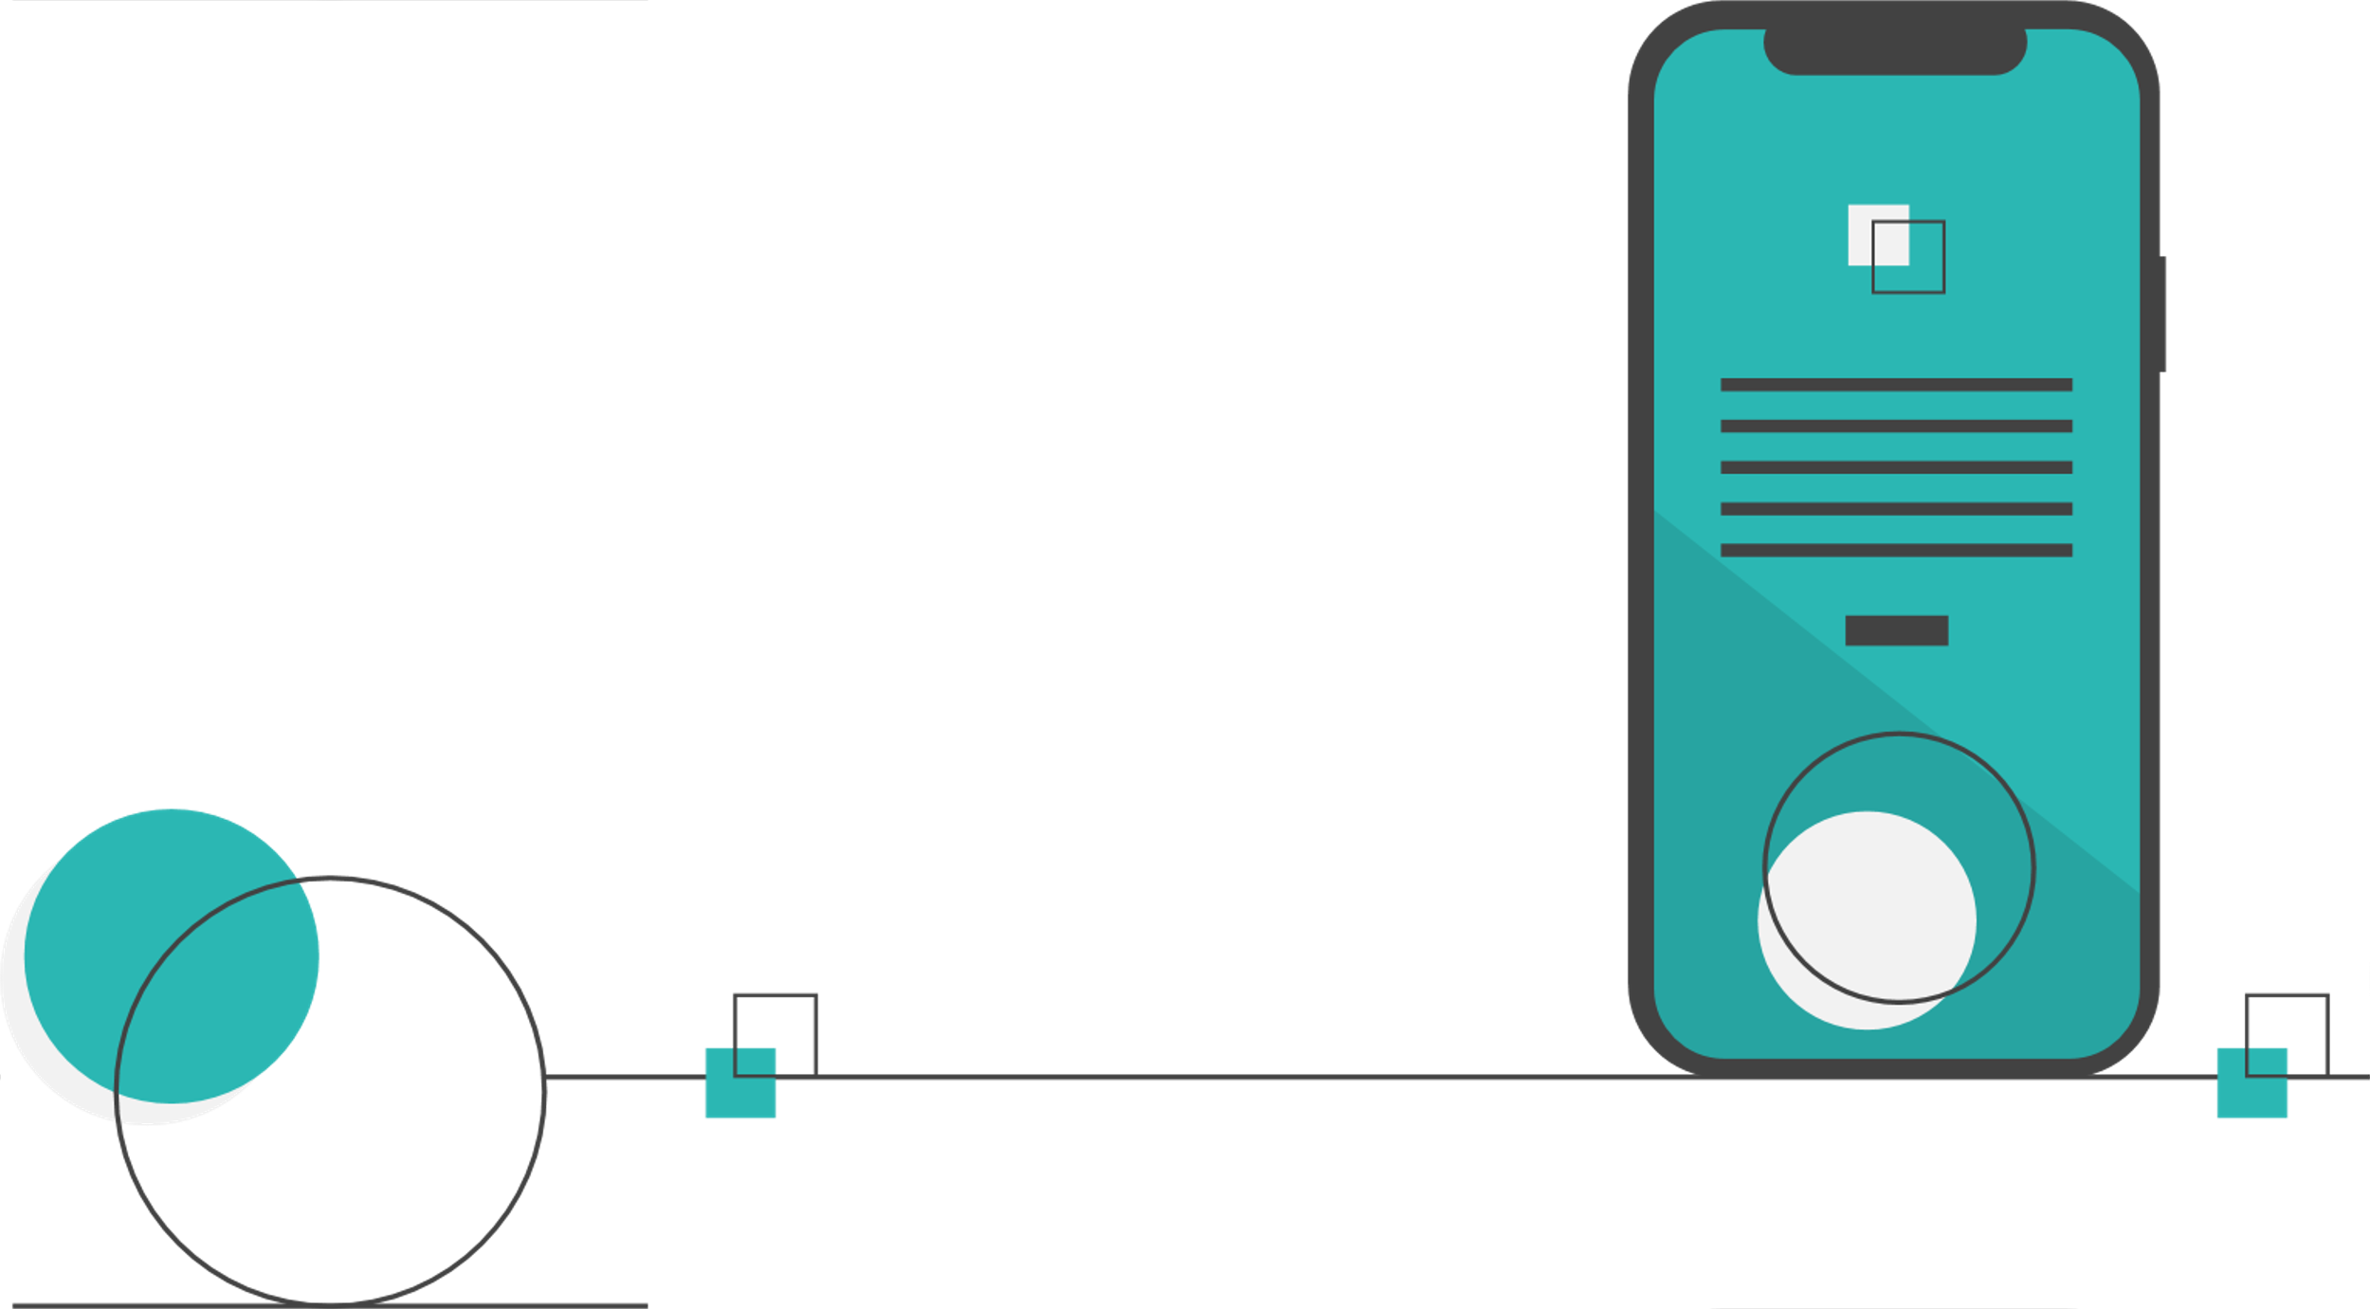

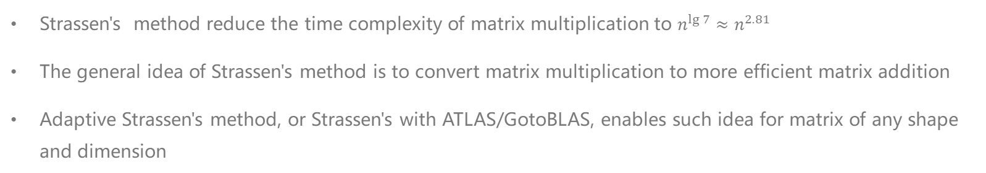
概述 OUTLINE
https://github.com/SamuelHuang2019/dsaa-project-matrix
Presented by HUANG Guanchao, SID 11912309 from SME
With team members:
ZHENG Shuhan, SID 11712401 from PHY
LI Yuru, SID 11911035 from EIE
TIAN Yuqiong, SID 11911039 from EIE
Strassen's method reduce the time complexity of matrix multiplication to $n^{\lg{7}}≈n^{2.81}$
The general idea of Strassen's method is to convert matrix multiplication to more efficient matrix addition
Adaptive Strassen's method, or Strassen's with ATLAS/GotoBLAS, enables such idea for matrix of any shape and dimension
Notes:
Matrix multiplication, or simply, MM, is very important for us and it has many applications in a variety of areas.
==========
We know that, for an intuitive standard MM algorithm, it has 3 loops, hence its time complexity is Theta n cube.
However, Strassen's method can reduce the complexity to n to the power of lg 7, which is approximately n to the power of 2.81. The key idea of such an amazing optimization is to convert complex and slow MM to more but more efficient matrix additions, or MAs.
In the algorithm proposed by Strassen, matrix is divided in a certain way, hence, it is obvious that such algorithm has many restrictions on the size and shape of the operands. Adaptive Strassen's method, or combination of Strassen's with ATLAS/GotoBLAS, enables such idea for matrix of any shape and dimension, this is what we implemented in this project, with Python.
Another thing is that, indeed Python has many advantages, with its elegance and generality, etc. Although I'm more familiar with Java, and two girls in our group don't even know nothing about Python, the reason I chose it is because I want to practice my Python skills through this project.
Theoretical analysis of these algorithms is the same for everyone, so we're gonna skip this.
==========
The first part is about our code implementation.

Slide 4

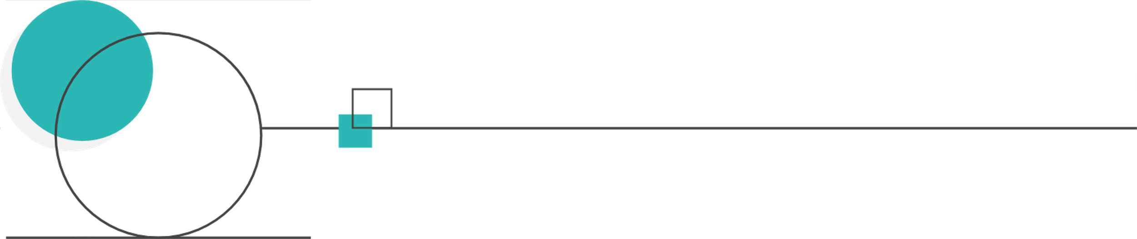
1
代码实现
CODE IMPLEMENTATION
Talk is cheap, show you the code. Data structure, classes and functions.
Notes:
The first part is about our code implementation.
With data structures we wrote, and how we implement the algorithms.
==========
This is our developing platform

Slide 5






开发平台
DEVELOPING PLATFORM
PyCharm
Version 2020.3, Professional edition Charming IDE with powerful performance analysis tools
Python 3.9.1
Newest features are always welcomed XD
GitHub
Most generally used version control and code cooperation tool
Windows 10
Professional edition version 20H2
VSCode
Lightweight but multifunctional IDE in supplement to PyCharm
Also works well with Markdown
Notes:
This is our developing platform
==========
with Windows 10 and newest version of Python, 3.9.1
Charming IDE PyCharm
GitHub for cooperation
and lightweight VSCode, which works well with writing report in Markdown.
==========
Talk is cheap, I show you the code, the very first thing is our Matrix class data structure

Slide 6


矩阵类
MATRIX CLASS
def __init__(self, elements, row=1, col=None):
"""
Initializes the matrix
:param elements: Elements in the matrix, in row-major order
:param row: The number of rows
:param col: The number of columns
:type row: int
:type col: int
"""
if col is None:
col = len(elements) // row
if len(elements) != row * col:
print('Invalid matrix size')
self.elements = elements
self.row = row
self.col = col
def __str__(self):
def __getitem__(self, item):
def __add__(self, other):
def __sub__(self, other):
def __sizeof__(self):
def dimension(self):
Notes:
Talk is cheap, I show you the code, the very first thing is our Matrix class data structure
==========
Matrix class has 3 members, elements is a list, storing the elements in the matrix in row-major order, and row, col for its dimension.
==========
As for the data structure operations, first, indexing is important.

Slide 7
矩阵类 – 索引
MATRIX CLASS - INDEXING
def __str__(self):
def __getitem__(self, item):
def __add__(self, other):
def __sub__(self, other):
def __sizeof__(self):
def dimension(self):
B = A[a:b, c:d] # matrix slice
B = A[a:b, c] # row slice
B = A[a, b:c] # column slice
B = A[a, b] # row-column indexing
B = A[a] # indexing in list of elements
Remember this! We'll come back later!
Notes:
As for the data structure operations, indexing is important.
==========
Our__getitem__ function is overridden, hence we can access the elements in the matrix very conveniently and flexibly.
We can index the matrix with two slice, or one slice one integer, or two integers, or single integer, which is quite similar to matrix in MATLAB.
And please remember such convenience provided by getitem function, we'll come back later
==========
Also, we have overridden the operators for addition and subtraction.

Slide 8
矩阵类 – 算符重载
Matrix class – operators override
def __str__(self):
def __getitem__(self, item):
def __add__(self, other):
def __sub__(self, other):
def __sizeof__(self):
def dimension(self):
A = Matrix(e1)
B = Matrix(e2)
C = A + B
D = A - B
Notes:
Also, we have overridden the operators for addition and subtraction.
Now our matrix supports directly add or subtract with a plus or minus sign, which is very simple.
==========
We also have some other class methods that are less important.

Slide 9
异常类
EXCEPTIONS CLASS
class RowOutOfBoundsException(Exception):
def __init__(self, index):
err = 'The row index out of bounds:', index
Exception.__init__(self, err)
class ColumnOutOfBoundsException(Exception):
class IndexOutOfBoundsException(Exception): class DimensionInconsistentException(Exception):
class InvalidElementException(Exception):
Notes:
We also have some other class methods that are less important.
==========
Also, we created exceptions class for matrix.
The above is our data structure. As you can see, it is with nice flexibility, can be easily accessed.
==========
As for the implementation of matrix multiplication, the square matrix multiplication is just trivial, so we're gonna skip that.

Slide 10
函数 – 适应性矩阵加减法
FUNCTION – ADAPTIVE MATRIX ADDITION AND SUBTRACTION
def adaptive_add(a, b, target_row, target_col):
arow = a.row
acol = a.col
brow = b.row
bcol = b.col
s = [0] * (target_col * target_row)
for i in range(target_row):
for j in range(target_col):
flag = False
if 0 <= i < a.row and 0 <= j < a.col:
s[i * target_col + j] = a[i + 1, j + 1]
flag = True
if 0 <= i < b.row and 0 <= j < b.col:
s[i * target_col + j] = s[i * target_col + j] + b[i + 1, j + 1]
flag = True
if not flag:
s[i * target_col + j] = 0
c = Matrix(s, target_row, target_col)
return c
Notes:
As for the implementation of matrix multiplication, the square matrix multiplication is just trivial, so we're gonna skip that.
==========
To realize the adaptive Strassen's method, we need adaptive matrix addition and subtraction first, we wrote functions for them.
==========
This part I think is also quite trivial, since we already have pseudocode for them, and our data structure is so flexible and convenient

Slide 11
函数 – 矩阵乘法
FUNCTION – MATRIX MULTIPLICATION
def strassen_multiply(a, b):
"""
The implementation of pseudocode given in the paper.
Use the Strassen to multiply 2 matrices a and b, return their product.
"""
def square_matrix_multiply(a, b):
"""
Use the standard approach to multiply 2 matrices a and b, return their product.
"""
Notes:
This part I think is also quite trivial, since we already have pseudocode for them, and our data structure is so flexible and convenient
=========
It even supports matrix slice indexing, which is very important in Strassen's method for dividing matrix.
You can view our source code at our GitHub repo, I won't present it here.
=========
Another thing is, we also have a function for generating required random matrices for test

Slide 12
函数 – 随机矩阵生成
FUNCTION – RANDOM MATRIX GENERATION
def random_matrix_gen(m, n=None):
"""
Generates a random matrix of size n by n, the elements are randomly from -1 to 1 float number.
:param m: dimension
:param n: optional dimension
:type m: int
:type n: int
:return: The generated random matrix
:rtype Matrix
""
n = m if n is None else n
elements = []
for i in range(m * n):
elements.append(random.uniform(-1, 1))
return Matrix(elements, m, n)
Notes:
Another thing is, we also have a function for generating required random matrices for test
==========
This part is also trivial.
==========
So, let's just dive into the experiments, to see how these codes behaves

Slide 13
2
算法测试
ALGORITHM EXPERIMENTS
Tests, statistics, tables, graphs, plots.
Notes:
So, let's just dive into the experiments, to see how these codes behaves
==========
The very first thing for this part, is our testing platform

Slide 14


HARDWARE
AMD Ryzen 9 3900X, with 12 cores, running at 3.8GHz, maximum turbo frequency 4.6GHz
ADATA DDR4 3200MHz 16GB × 4, running at 2666MHz, quad channel
Gigabyte X570 Gaming X
SOFTWARE
Windows 10 Professional 20H2
Python 3.9.1
PyCharm 2020.3, Professional Edition
Visual Studio Community 2019
SOME LIGHTWEIGHT TESTS ARE CONDUCTED ON
Microsoft Surface Pro 6 1796
Intel Core i7-8650U 1.99GHz, running at 2.11GHz, maximum Turbo frequency 4.2GHz
8GB of RAM, dual channel, running at 1867MHz
测试平台
TESTING PLATFORM
Notes:
The very first thing for this part, is our testing platform
==========
Our testing platform is AMD Ryzen 9 3900X, with 12 cores and 24 threads, maximum turbo frequency 4.6GHz
16GB of RAM times 4, in quad channel, in total 64GB of RAM.
Software condition is the same as our developing platform.
Some other lightweight tests are conducted on my own Surface Pro 6.
==========
Before our real experiments starts, we need to know more about what we can do with this powerful Ryzen CPU.

Slide 15

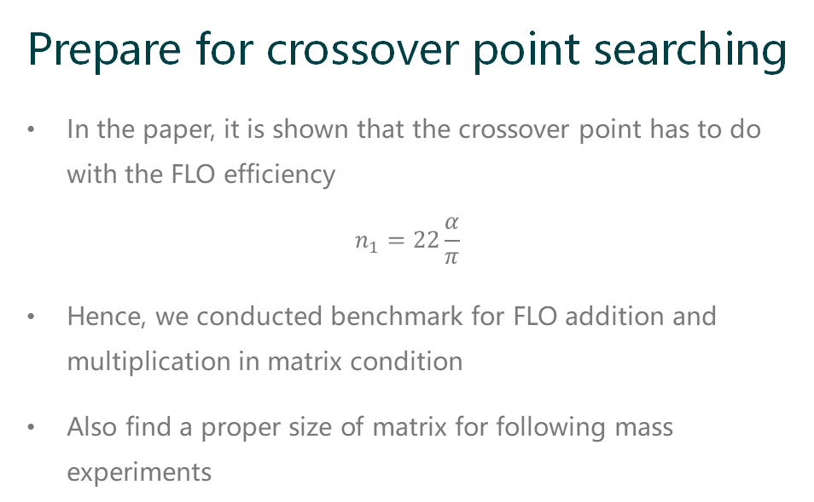
准备工作 – 性能基准测试
PREPARATION – PERFORMANCE BENCHMARK
Prepare for crossover point searching
In the paper, it is shown that the crossover point has to do with the FLO efficiency
$$n_{1}=22\frac{α}{π}$$
Hence, we conducted benchmark for FLO addition and multiplication in matrix condition
Also find a proper size of matrix for following mass experiments
Notes:
Before our real experiments starts, we need to know more about what we can do with this powerful Ryzen CPU.
==========
In the paper, the authors indicate that, the crossover point is related to how computer deals with floating point addition and multiplication
They even give us an expression for the crossover point, in which alpha is the efficiency of floating-point addition, pi is that of multiplication.
So, first we ran a floating-point operation benchmark on our platform to estimate the crossover point.
Also, in order to find out a proper size of matrix for following tests, not too small, not too big.
==========
To simulate the real case of addition and multiplication under our matrix environment, we took the process of indexing into consideration

Slide 16
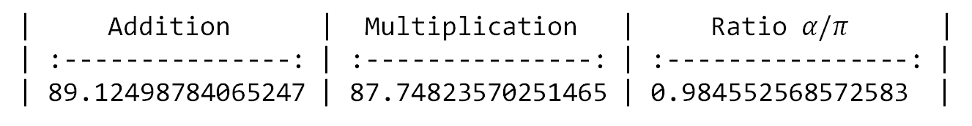
准备工作 – 性能基准测试
PREPARATION – PERFORMANCE BENCHMARK
| Addition | Multiplication | Ratio $α/π$ |
| :---------------: | :---------------: | :----------------: |
| 89.12498784065247 | 87.74823570251465 | 0.984552568572583 |
n = 8192
m1 = random_matrix_gen(n)
m2 = random_matrix_gen(n)
time1 = time.time()
for i in range(n * n):
s = m1[i] + m2[i]
time2 = time.time()
print(time2 - time1)
Wired result! And we'll explain this later!
Notes:
To simulate the real case of addition and multiplication under our matrix environment, we took the process of indexing into consideration
==========
First, two 8192 by 8192 matrices are generated, and floating-point operations are conducted among these 2 to the power of 26 elements.
The result is really weird, the addition and multiplication both took about 90 seconds, hence the ratio is very close to 1.
However, generally multiplication should be much slower than addition, the essay also indicates that this crossover point is about 1100, which is far larger than our result.
This is weird, and we'll explain this to you later.
==========
The next thing is searching the crossover point.

Slide 17
递归点搜寻 – 代码
CROSSOVER POINT SEARCHING - CODE
n = 512 # matrix size
s = 1 # start point
e = 64 # end point
r = 2 # each test runs twice
m1 = random_matrix_gen(n)
m2 = random_matrix_gen(n) wb = openpyxl.load_workbook('data.xlsx')
ws = wb['crossover_point']
# using openpyxl to record results
# outer loop for i in range(s, e + 1):
strassen = 0
square = 0
ws['A' + str(i)] = i
# inner loop
for j in range(1, r + 1): time1 = time.time()
c = strassen_multiply(m1, m2, i)
time2 = time.time()
strassen = time2 - time1 + strassen
time1 = time.time()
c1 = square_matrix_multiply(m1, m2)
time2 = time.time()
square = time2 - time1 + square
ws['B' + str(i)] = strassen / r
ws['C' + str(i)] = square / r
wb.save('data.xlsx') # save workbook
Notes:
The next thing is searching the crossover point.
==========
From our previous test, we consider 512 by 512 matrix is proper, since its runtime won't be too long for conducting a series of linear search.
The range for searching is from 1 to 64
In order to obtain a more reliable and stable result, for each matrix, Strassen's multiplication and standard multiplication is conducted twice and taken average.
Using the openpyxl package, we stored the result in an Excel workbook.
==========
The result is as follows.

Slide 18
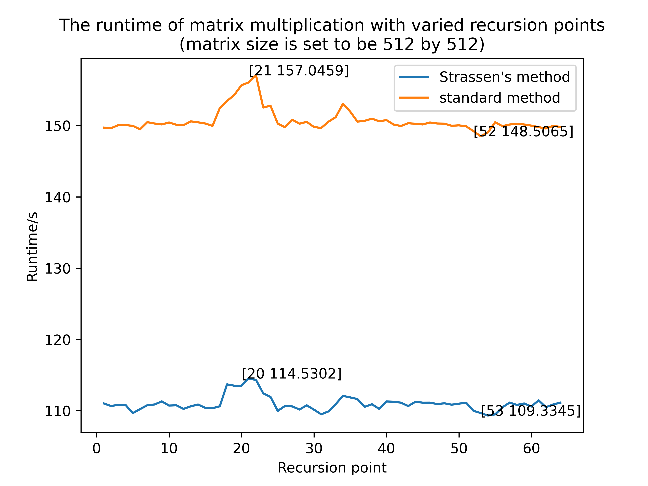
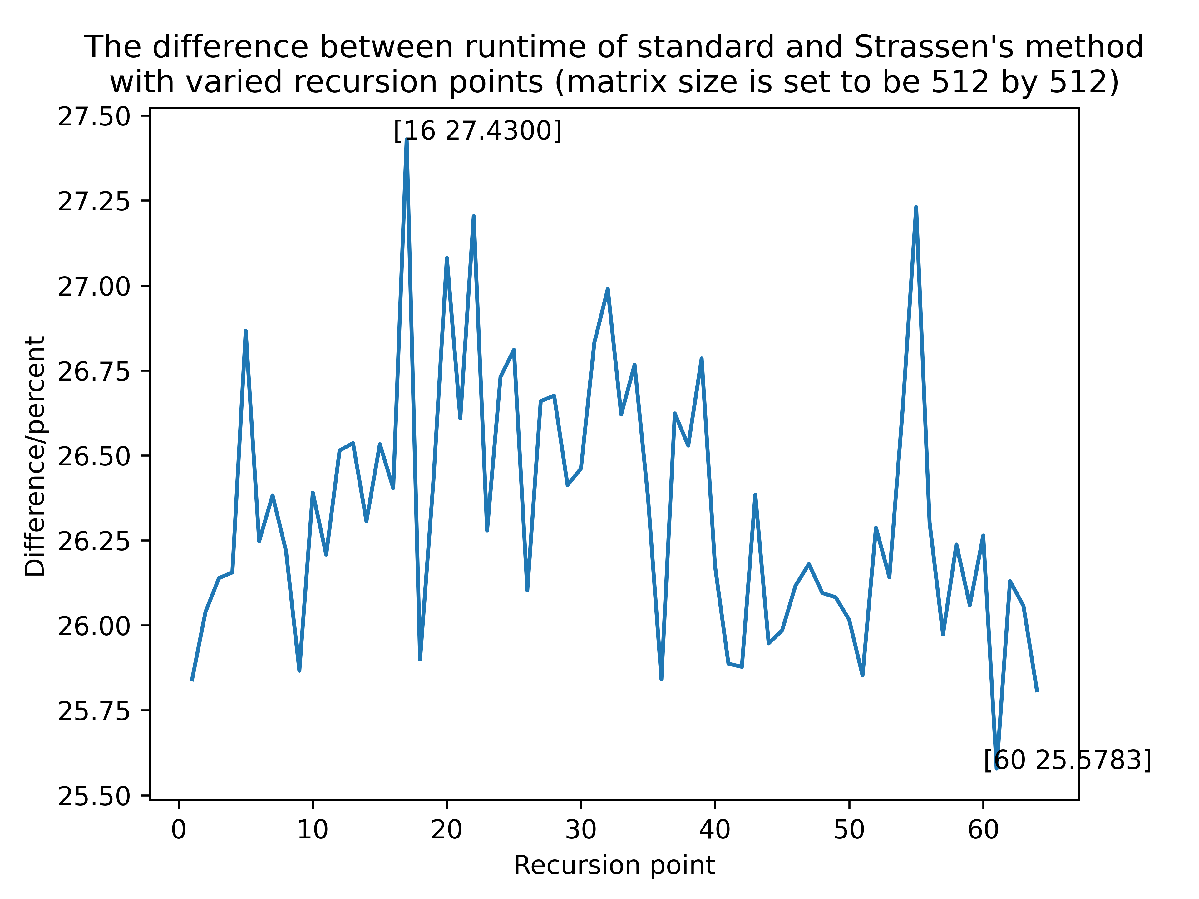
递归点搜寻 – 结果
CROSSOVER POINT SEARCHING - RESULT
Notes:
The result is as follows.
==========
These figures are plotted with matplotlib, with very nice appearance.
Let's look at the left one. First, we can see that the Strassen's method is stably faster than the standard approach for about 40s.
And further, it is clear that the two lines are fluctuating synchronously. Hence, we can conclude that this is due to the other workload on the computer.

Slide 19
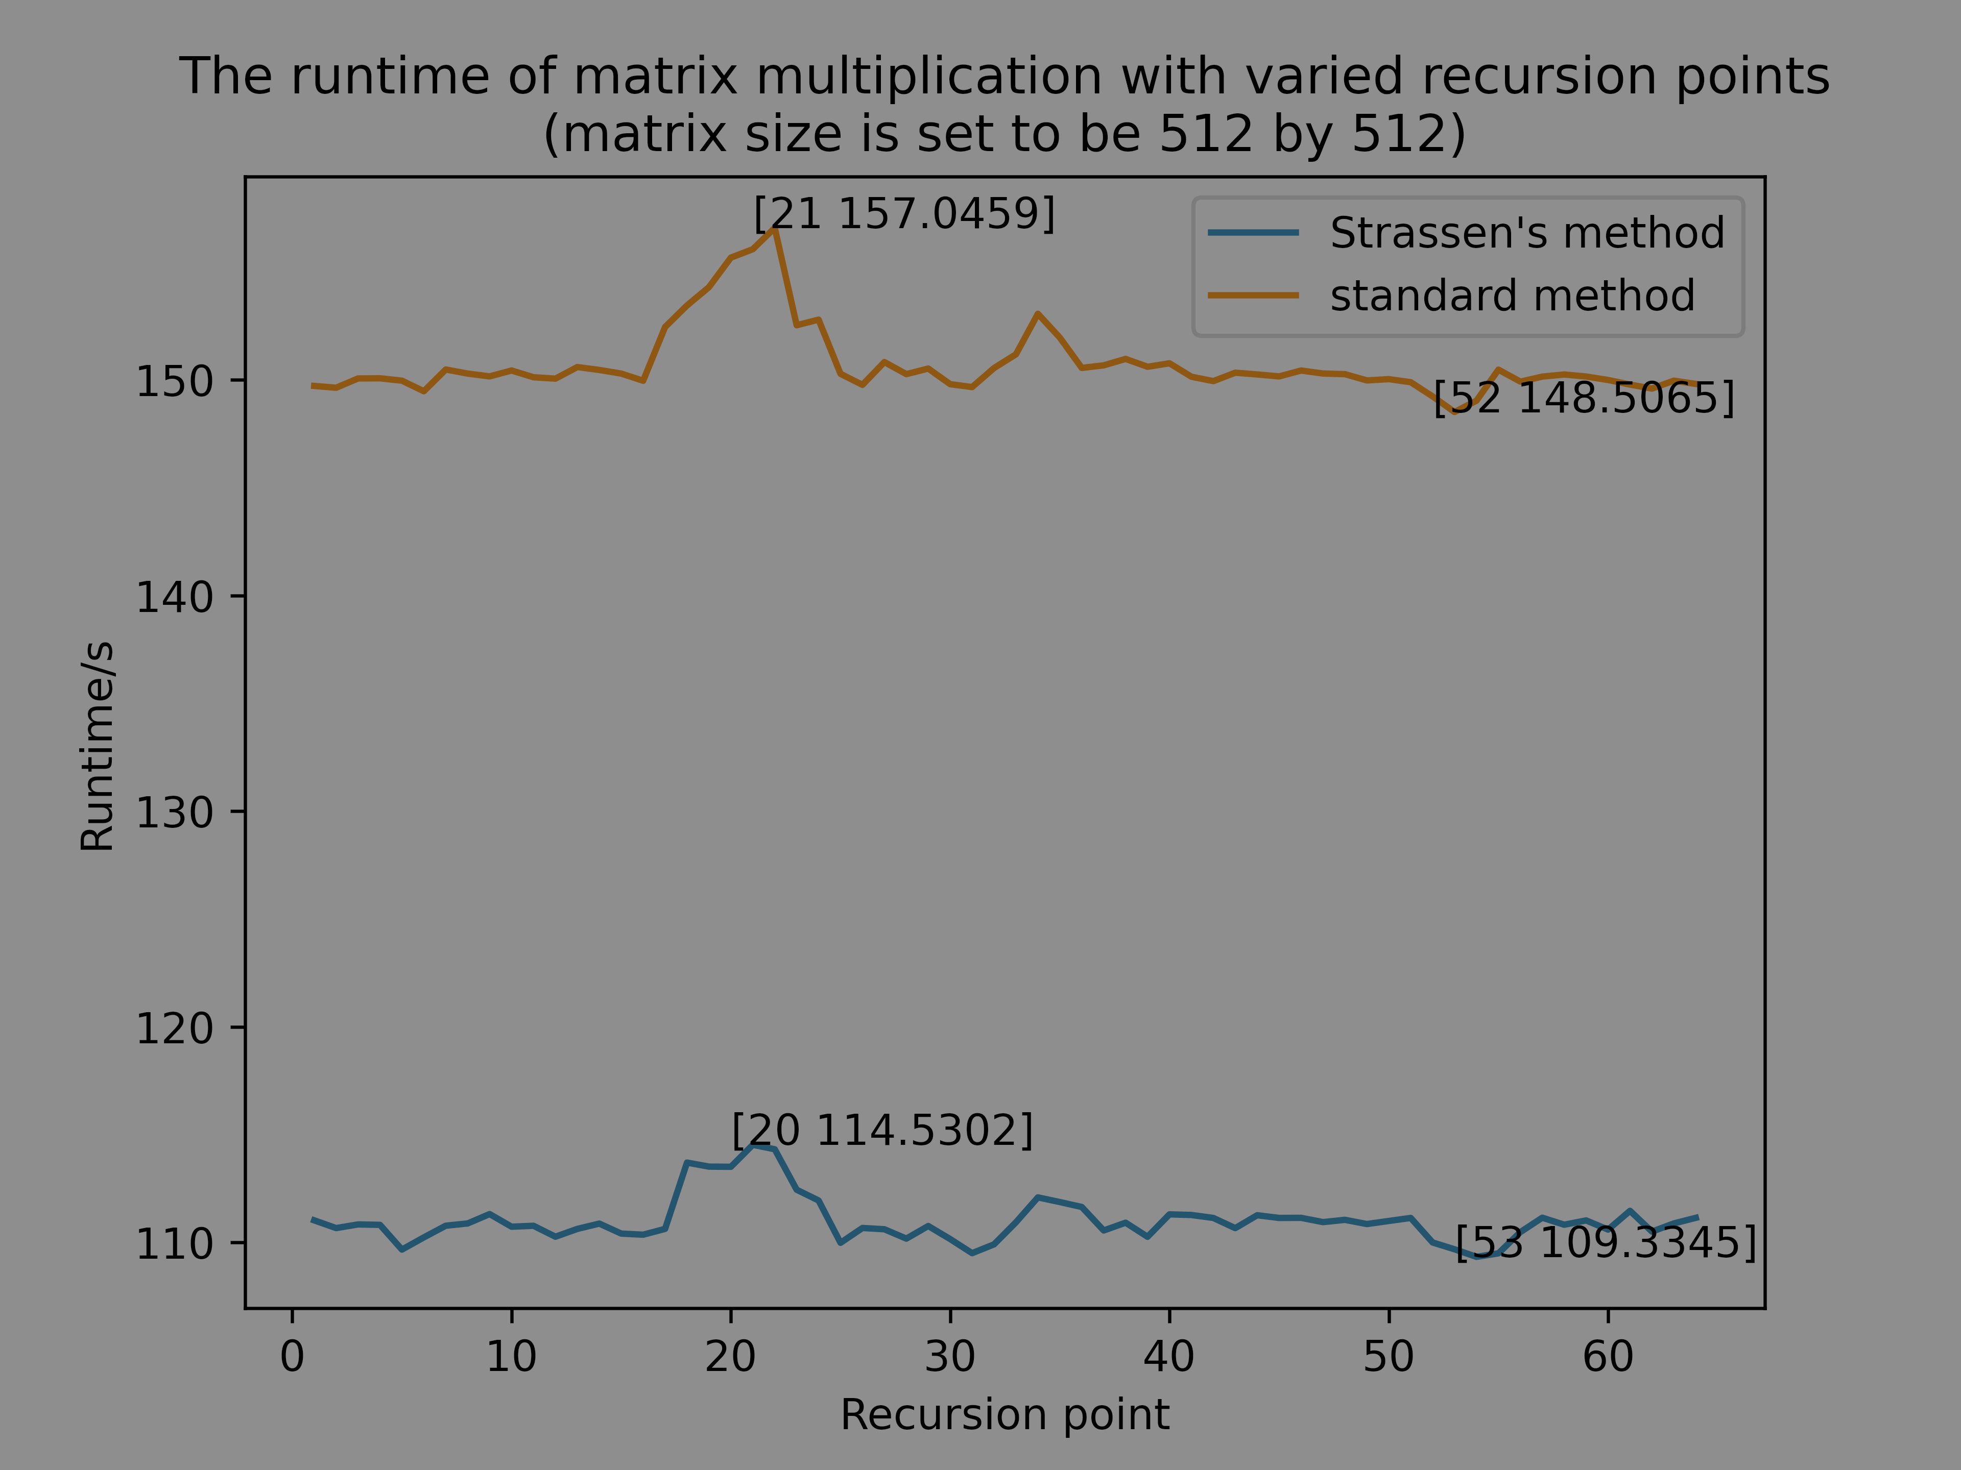
递归点搜寻 – 同步涨落
CROSSOVER POINT SEARCHING – SYNCRONOUS FLUCTUATION
Notes:
The result is as follows.
==========
These figures are plotted with matplotlib, with very nice appearance.
Let's look at the left one. First, we can see that the Strassen's method is stably faster than the standard approach for about 40s.
And further, it is clear that the two lines are fluctuating synchronously. Hence, we can conclude that this is due to the other workload on the computer.

Slide 20
递归点搜寻 – 同步涨落
CROSSOVER POINT SEARCHING – SYNCRONOUS FLUCTUATION
Notes:
The result is as follows.
==========
These figures are plotted with matplotlib, with very nice appearance.
Let's look at the left one. First, we can see that the Strassen's method is stably faster than the standard approach for about 40s.
And further, it is clear that the two lines are fluctuating synchronously. Hence, we can conclude that this is due to the other workload on the computer.

Slide 21
递归点搜寻 – 同步涨落
CROSSOVER POINT SEARCHING – SYNCRONOUS FLUCTUATION
Notes:
The result is as follows.
==========
These figures are plotted with matplotlib, with very nice appearance.
Let's look at the left one. First, we can see that the Strassen's method is stably faster than the standard approach for about 40s.
And further, it is clear that the two lines are fluctuating synchronously. Hence, we can conclude that this is due to the other workload on the computer.
==========
More intuitively, the right-hand-side is the difference of the runtime in percentage.

Slide 22
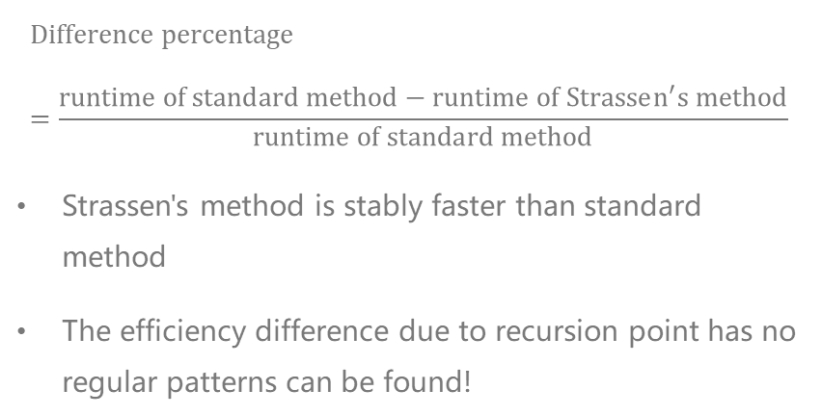
递归点搜寻 – 无规律结果
CROSSOVER POINT SEARCHING – NO REGULAR PATTERN
$$Difference percentage=\frac{runtime of standard method−runtime of Strassen^{′}s method}{runtime of standard method}$$
Strassen's method is stably faster than standard method
The efficiency difference due to recursion point has no regular patterns can be found!
Weird result again!
Notes:
More intuitively, the right-hand-side is the difference of the runtime in percentage.
==========
Which is defined as the equation shows. There is no obvious regular pattern could be found.
According to these experiments, we know that Strassen's method is always faster than standard method, the effect on the performance of Strassen's method due to the recursion point can be ignored.
This is a weird result again; you must have come up with a big question mark now, we'll make an explanation later on.
==========
The next part is to find the time complexity

Slide 23
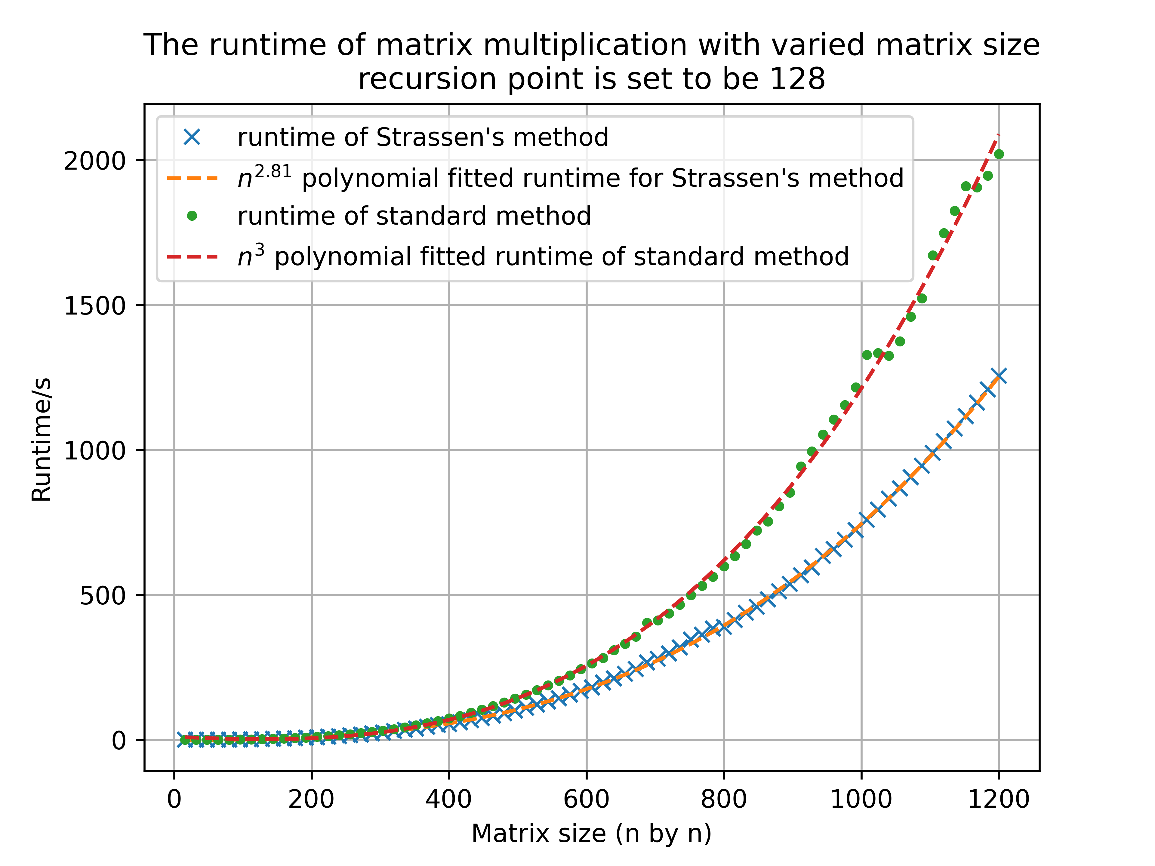
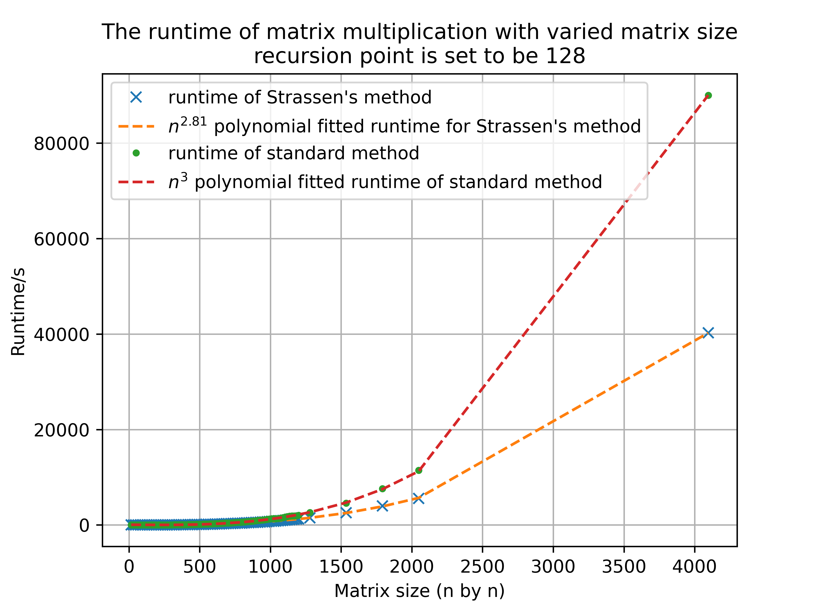
方形矩阵乘法
SQAURE MATRICES MULTIPLICATION
Notes:
The next part is to find the time complexity
==========
The left part shows the runtime for matrices with dimension 1 by 1 to 1200 by 1200.
The green dots around upper curve, is the runtime of standard method, and the dashed curve is its n cube polynomial fitted curve
The blue x under that, is the runtime of adaptive Strassen’s method, with its n to the power of 2.81 fitted curve.
The figure in the right-hand-side is the same as the left but adding a few results from larger matrices.
It’s clear that the time complexity in asymptotic notation for standard method is Theta n cube, and that of adaptive Strassen’s method is Theta n to the power of lg 7
Which perfectly corresponds with our expectation.
==========
Also, we conducted a test for different matrix shape.

Slide 24
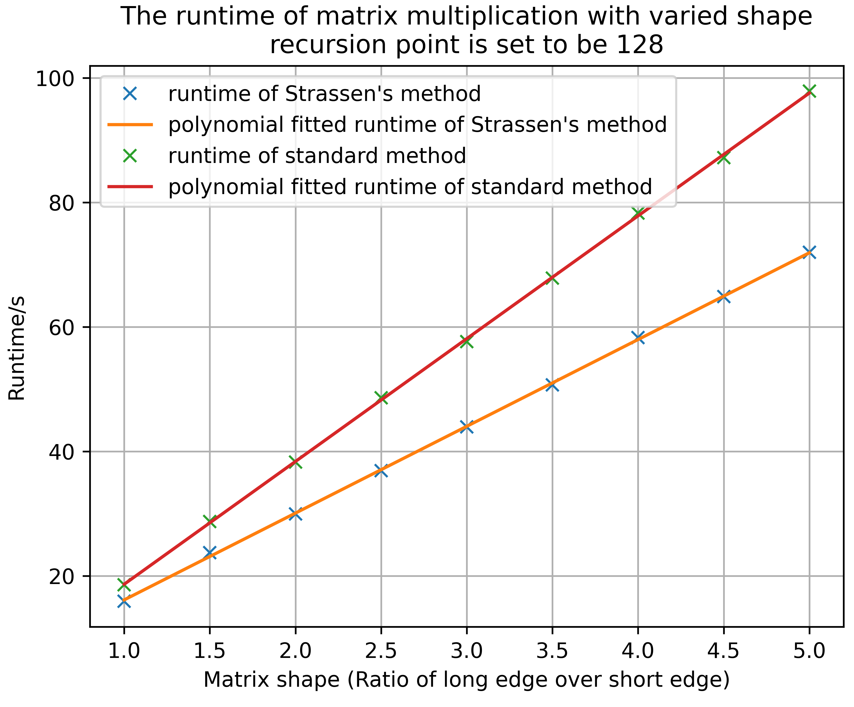
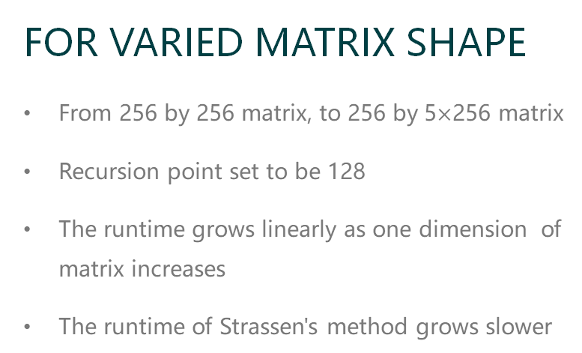
FOR VARIED MATRIX SHAPE
From 256 by 256 matrix, to 256 by 5$×$256 matrix
Recursion point set to be 128
The runtime grows linearly as one dimension of matrix increases
The runtime of Strassen's method grows slower
矩形矩阵乘法
RECTANGULAR MATRICES MULTIPLICATION
Notes:
Also, we conducted a test for different matrix shape.
==========
In this experiment, we tested multiplication for matrix of dimension 256 by 256 to 1280, so the ratio of the long edge over short edge runs from 1 to 5.
We can see that, as one dimension of the matrix increase, the runtime of two methods both grows linearly, however, the runtime of adaptive Strassen's method grows slower.
I think this conclusion is also abnormal, since the adaptive method shouldn't be so efficient with rectangular matrices.
==========
So far, we've still got some questions remained.

Slide 25




遗留的问题
QUESTIONS REMAINED
Result for FLO benchmark is absurd
Strassen's method seems to be too "fast"
Recursion point has no effect on performance
50%
90%
40%
20%
60%
30%
Notes:
So far, we've still got some questions remained.
==========
Firstly, the result of FLOPs benchmark is quite absurd.
Secondly, adaptive Strassen's method seems to be too fast
And thirdly, the recursion point has no effect on the runtime at all.
==========
Based on these questions, let's take a deeper look in the performance.

Slide 26
3
性能分析
PERFORMANCE ANALYSIS
Why these algorithms behaves strangely?
Notes:
Based on these questions, let's take a deeper look in the performance.
==========
In this experiment, we utilized the cprofile tool integrated in PyCharm to analyze the FLO benchmark.

Slide 27
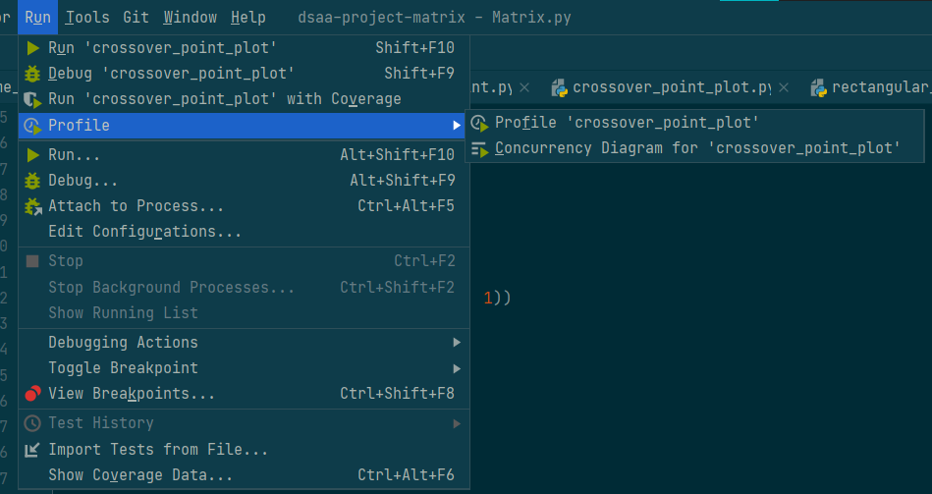
FLO 基准测试的细节
MORE ON FLO BENCHMARK
CPROFILE TOOL IN PYCHARM
Runtime of each function
Call amount of each function
Call trees and graphs
Notes:
In this experiment, we utilized the cprofile tool integrated in PyCharm to analyze the FLO benchmark.
==========
Which enables us to record the call amounts, runtime and call tress of each function involved.
==========
This picture shows the call tree in the addition test.

Slide 28
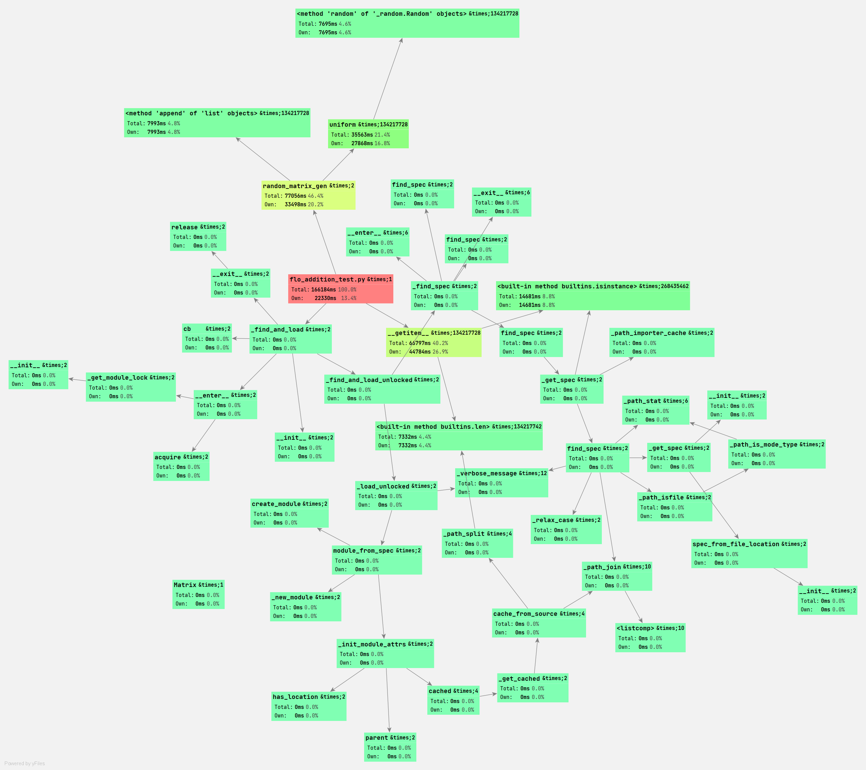
FLO 基准测试的细节
MORE ON FLO BENCHMARK
CALL GRAPH OF ADDITION
Deeper color, longer time
Main script takes all the CPU time
Random matrix generation costs time
__getitem__ function for indexing is slow
Notes:
This picture shows the call tree in the addition test.
==========
Overall, the blocks with deeper color has the longer runtime.
The red block in the center, is our test script, therefore took up 100 percent of the runtime
The process for generating random matrices also took a lot of time, but they are not considered in the runtime.
What we discovered is that, getitem method, which is for indexing took so much time in the whole process.
More detailly, it's the isinstance function and len function cost the most of the time.
==========
The result for multiplication is almost the same

Slide 29
FLO 基准测试的细节
MORE ON FLO BENCHMARK
CALL GRAPH OF ADDITION
Deeper color, longer time
Main script takes all the CPU time
Random matrix generation costs time
__getitem__ function for indexing is slow
Notes:
This picture shows the call tree in the addition test.
==========
Overall, the blocks with deeper color has the longer runtime.
The red block in the center, is our test script, therefore took up 100 percent of the runtime
The process for generating random matrices also took a lot of time, but they are not considered in the runtime.
What we discovered is that, getitem method, which is for indexing took so much time in the whole process.
More detailly, it's the isinstance function and len function cost the most of the time.
==========
The result for multiplication is almost the same

Slide 30
FLO 基准测试的细节
MORE ON FLO BENCHMARK
CALL GRAPH OF ADDITION
Deeper color, longer time
Main script takes all the CPU time
Random matrix generation costs time
__getitem__ function for indexing is slow
Notes:
This picture shows the call tree in the addition test.
==========
Overall, the blocks with deeper color has the longer runtime.
The red block in the center, is our test script, therefore took up 100 percent of the runtime
The process for generating random matrices also took a lot of time, but they are not considered in the runtime.
What we discovered is that, getitem method, which is for indexing took so much time in the whole process.
More detailly, it's the isinstance function and len function cost the most of the time.
==========
The result for multiplication is almost the same

Slide 31
FLO 基准测试的细节
MORE ON FLO BENCHMARK
CALL GRAPH OF ADDITION
Deeper color, longer time
Main script takes all the CPU time
Random matrix generation costs time
__getitem__ function for indexing is slow
Notes:
What we discovered is that, getitem method, which is for indexing took so much time in the whole process.
More detailly, it's the isinstance function and len function cost the most of the time.
==========
The result for multiplication is almost the same

Slide 32
FLO 基准测试的细节
MORE ON FLO BENCHMARK
FOR __getitem__ METHOD
__isinstance__ method is called so many times
len() method is also called so many times
However, they are not related to core process of floating-point addition and multiplication
Notes:
What we discovered is that, getitem method, which is for indexing took so much time in the whole process.
More detailly, it's the isinstance function and len function cost the most of the time.
==========
The result for multiplication is almost the same

Slide 33
FLO 基准测试的细节
MORE ON FLO BENCHMARK
| Name | Call Count | Time (ms) | Time percentage | Own Time (ms) | Own time percentage |
| ----------------------------------------------- | ---------: | --------: | :-------------: | ------------: | :-----------------: |
| `flo_addition_test.py` | 1 | 164414 | 100.0% | 21216 | 12.9% |
| `random_matrix_gen` | 2 | 76665 | 46.6% | 32751 | 19.9% |
| `__getitem__` | 134217728 | 66532 | 40.5% | 44601 | 27.1% |
| `uniform` | 134217728 | 35841 | 21.8% | 28127 | 17.1% |
| \<built-in method `builtins.isinstance`\> | 268435462 | 14614 | 8.9% | 14614 | 8.9% |
| \<method `append` of `list` objects\> | 134217728 | 8072 | 4.9% | 8072 | 4.9% |
| \<method `random` of `_random.Random` objects\> | 134217728 | 7713 | 4.7% | 7713 | 4.7% |
| \<built-in method `builtins.len`\> | 134217742 | 7316 | 4.4% | 7316 | 4.4% |
RUNTIME FOR EACH FUNCTION IN MULTIPLICATION TEST
The table shows the runtime for each function in multiplication test
That for addition is similar
Not considering matrix generation, 74.95% of the runtime in addition and 75.82% in multiplication is spent on indexing
Notes:
The result for multiplication is almost the same
==========
This is the table for the runtime in floating-point multiplication test.
If we exclude the time for generating random matrices, about up to 75% of time in addition and multiplication is spent on indexing, what a waste of performance.
==========
If we look back at the matrix class, about its flexibility and generality in indexing elements.

Slide 34
矩阵类 – 索引
MATRIX CLASS - INDEXING
def __str__(self):
def __getitem__(self, item):
def __add__(self, other):
def __sub__(self, other):
def __sizeof__(self):
def dimension(self):
B = A[a:b, c:d] # matrix slice
B = A[a:b, c] # row slice
B = A[a, b:c] # column slice
B = A[a, b] # row-column indexing
B = A[a] # indexing in list of elements
# for tuple input
if isinstance(item, tuple):
# both of the elements in the item are slice
if isinstance(item[0], slice) and isinstance(item[1], slice):
... # one slice, one int
# both of the elements in the item are int
if isinstance(item[0], int) and isinstance(item[1], int):
...
# else for int input
if isinstance(item, int):
...
Notes:
If we look back at the matrix class, about its flexibility and generality in indexing elements.
==========
Under this ease of use, there are many lines of codes supporting it

Slide 35
矩阵类 – 索引
MATRIX CLASS - INDEXING
def __str__(self):
def __getitem__(self, item):
def __add__(self, other):
def __sub__(self, other):
def __sizeof__(self):
def dimension(self):
B = A[a:b, c:d] # matrix slice
B = A[a:b, c] # row slice
B = A[a, b:c] # column slice
B = A[a, b] # row-column indexing
B = A[a] # indexing in list of elements
# for tuple input
if isinstance(item, tuple):
# both of the elements in the item are slice
if isinstance(item[0], slice) and isinstance(item[1], slice):
... # one slice, one int
# both of the elements in the item are int
if isinstance(item[0], int) and isinstance(item[1], int):
...
# else for int input
if isinstance(item, int):
...
Notes:
Under this ease of use, there are many lines of codes supporting it
==========
Since Python doesn't have functions overloading as in Java
To support this, many comparisons and judgments are made, this is brick that drags the speed down
==========
The balance between code performance and user friendliness is of great significance.

Slide 36




PERFORMANCE
GENERALITY
EASE OF USE
易用性与代码性能
EASE OF USE AND CODE PERFORMANCE
Notes:
The balance between code performance and user friendliness is of great significance.
==========
Indeed, our data structure provides prominent ease of use for developers or users,
however, the performance cost is too high for the purpose of this project.
==========
In the final part, I will introduce our project management.

Slide 37
4
项目管理
PERFORMANCE MANAGEMENT
How we schedule the time, work and cooperate
Notes:
In the final part, I will introduce our project management.
==========
The whole project is divided into 4 stages,

Slide 38





项目规划
PROJECT SCHEDULING
3
4
REPORT
Composing report and preparing for the presentation.
EXPERIMENT
Test our algorithm performance, as well as data analysis
1
2
DEVELOPMENT
Coding data structures, implementing algorithms
PREPARATION
Basic knowledge for Python developing and code cooperation, as well as Markdown
Notes:
The whole project is divided into 4 stages, and accordingly, we created 4 projects on GitHub
In each of the project, there are many sub-missions

Slide 39
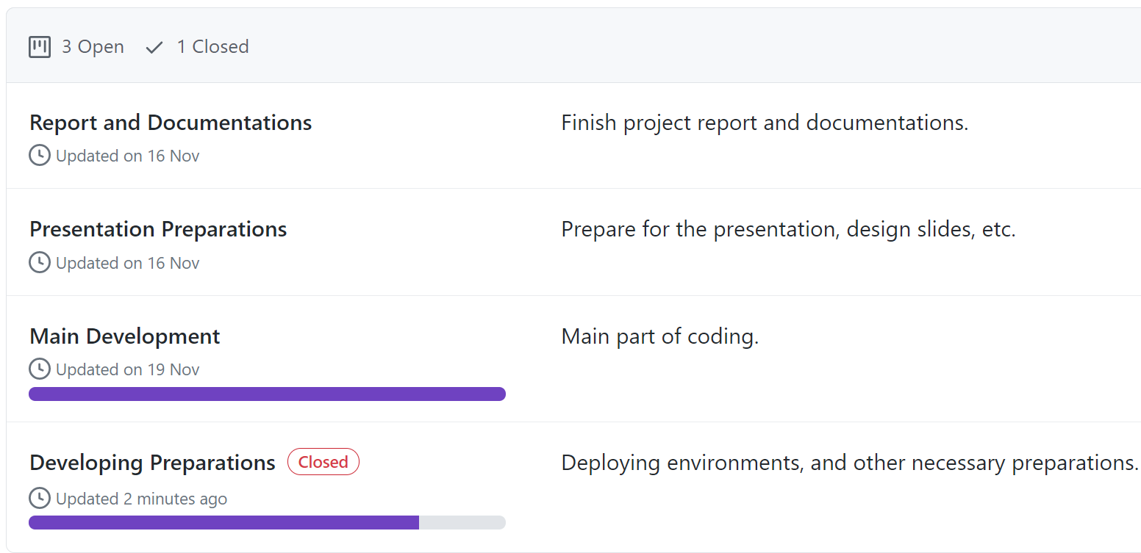
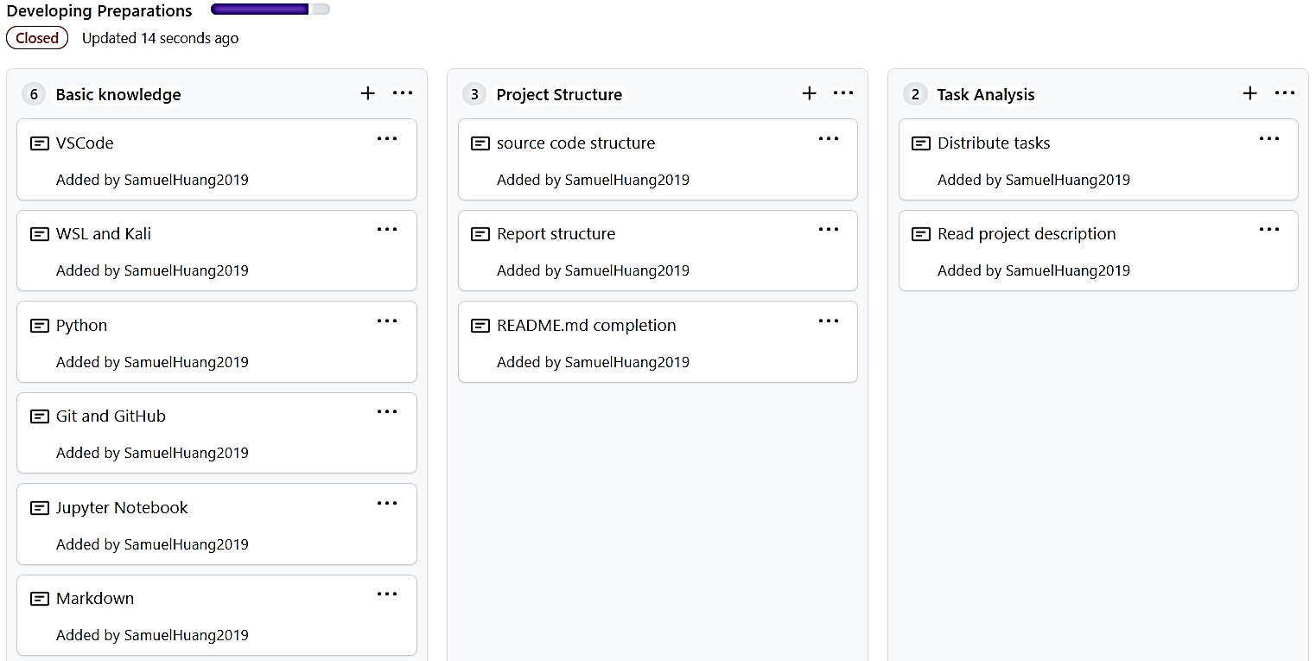
项目规划 - PROJECTS
PROJECT SCHEDULING - PROJECTS
Notes:
The whole project is divided into 4 stages, and accordingly, we created 4 projects on GitHub
In each of the project, there are many sub-missions

Slide 40
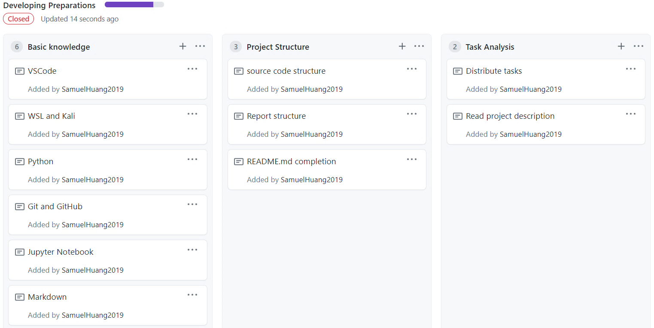
项目规划 - PROJECTS
PROJECT SCHEDULING - PROJECTS
Notes:
The whole project is divided into 4 stages, and accordingly, we created 4 projects on GitHub
In each of the project, there are many sub-missions
==========
Moreover, we opened some issues on GitHub while debugging, this is one example

Slide 41
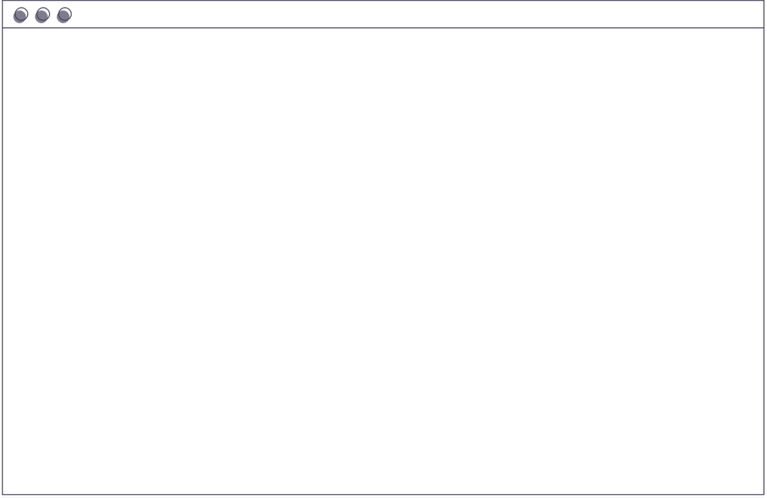
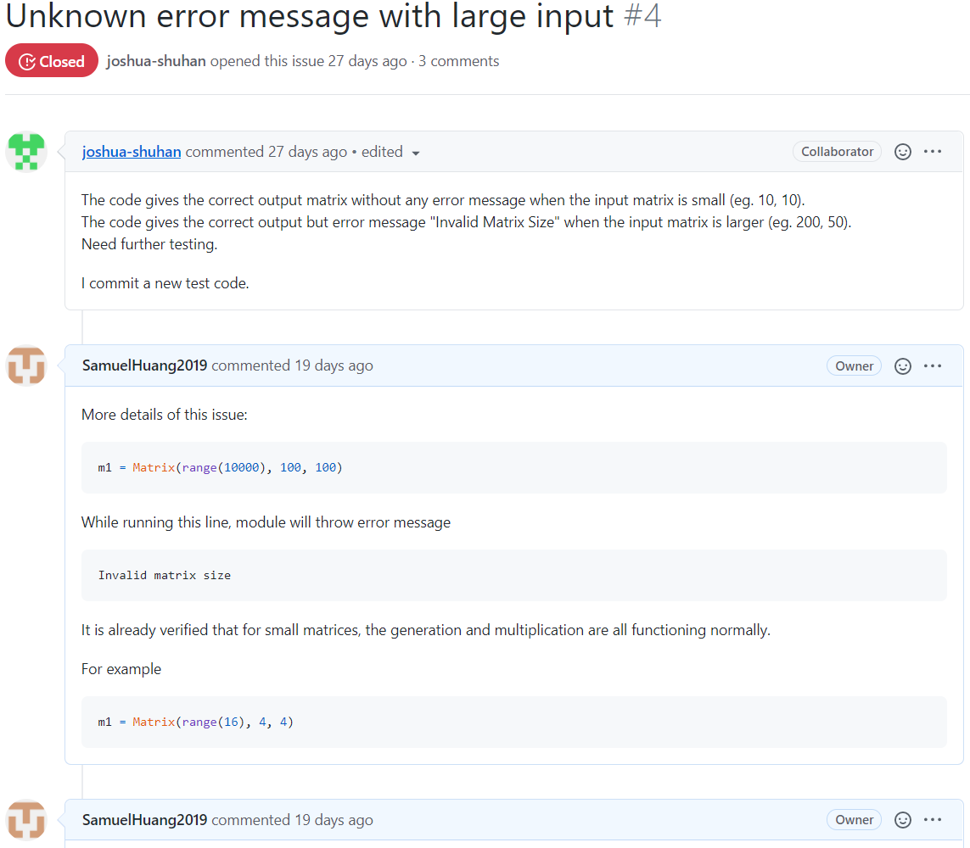
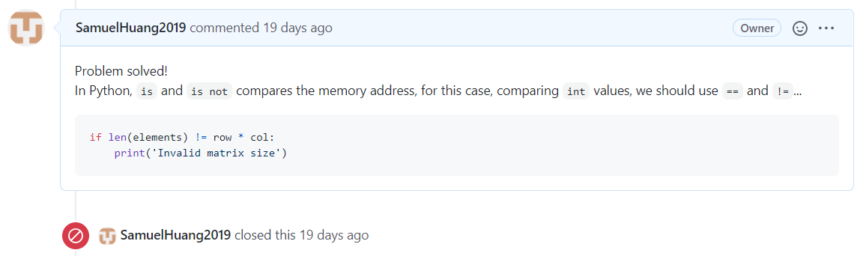
项目规划 - ISSUES
PROJECT SCHEDULING - ISSUES
Notes:
Moreover, we opened some issues on GitHub while debugging, this is one example

Slide 42
项目规划 - ISSUES
PROJECT SCHEDULING - ISSUES
Notes:
Moreover, we opened some issues on GitHub while debugging, this is one example
==========
The following is the contribution insight, for over a month

Slide 43
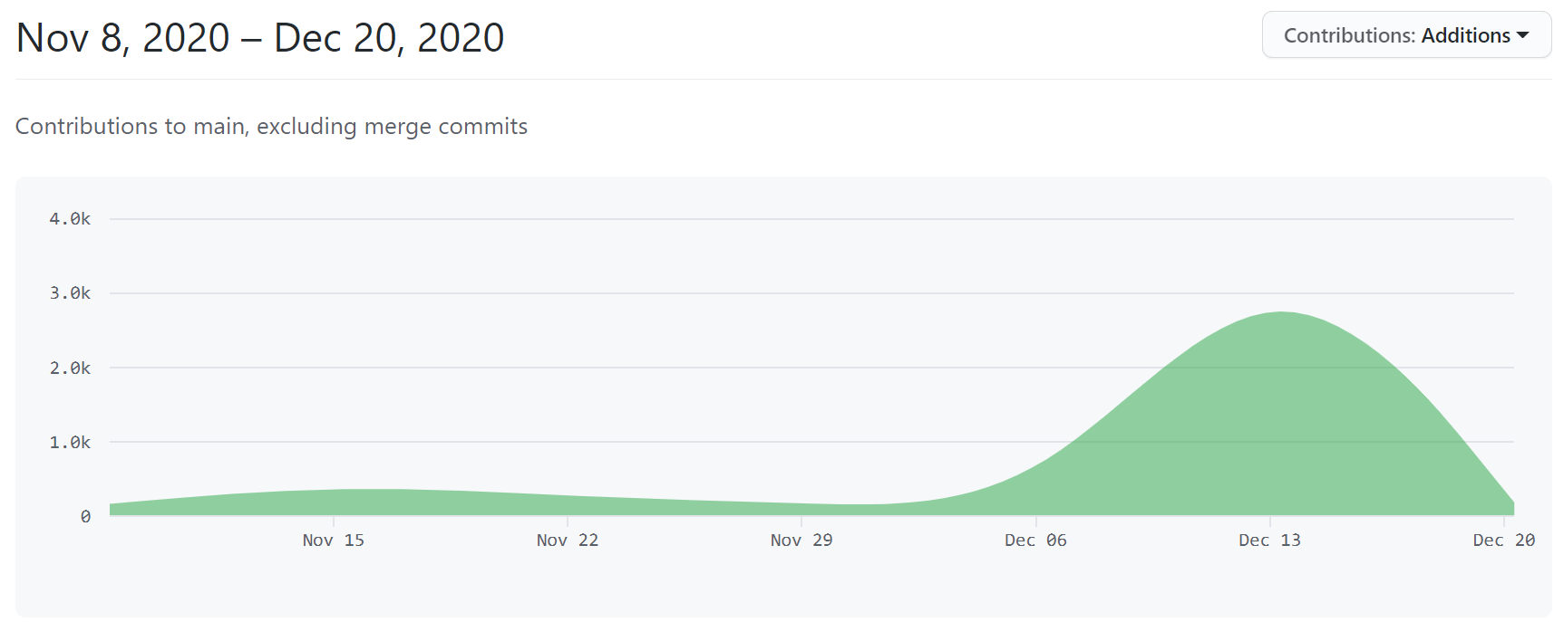
项目规划 - CONTRIBUTORS
PROJECT SCHEDULING - CONTRIBUTORS
Notes:
The following is the contribution insight, for over a month
=========
GitHub gives statistics for our work individually

Slide 44
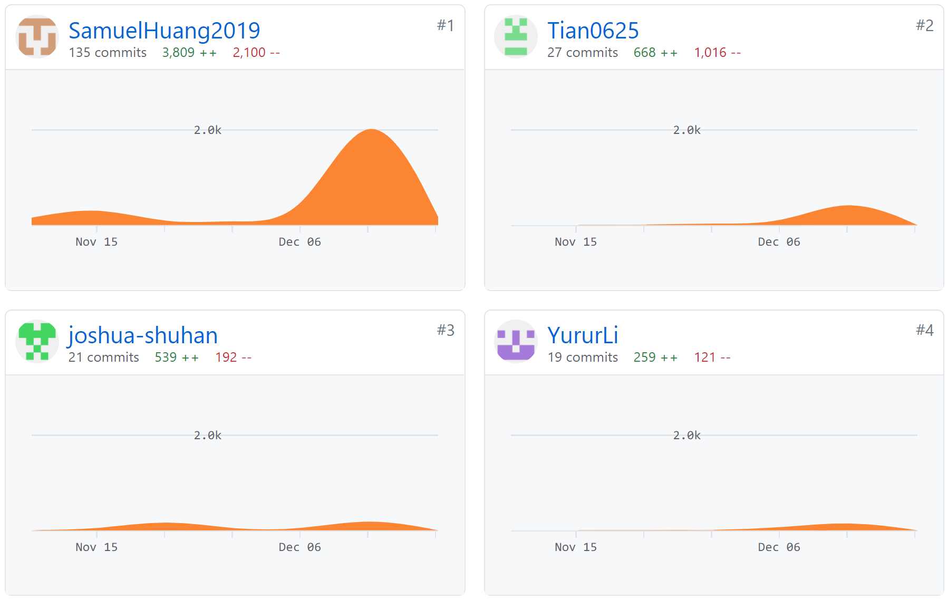
项目规划 - CONTRIBUTORS
PROJECT SCHEDULING - CONTRIBUTORS
Notes:
GitHub gives statistics for our work individually
==========
I wrote the matrix class, and conducted the tests and analysis, this slides is also my work, I’m also responsible for several parts in the report.
I have so many commits is because I’m directly working on and committing to main branch, I was using this to syncing my code with remote testing platform.
I also fixed a broken directory conflict caused by another member; you can find that one easily from line deletions.
---
Shuhan have only 21 commits is because he is working on his fork, he finished all the algorithm part, and have works in report. His contribution is also extremely crucial for us.
---
As for the rest two, I don’t want to comment too much on this, you can judge by your own.
Frankly, no-offence-ly, subjectively, I am not satisfied with their participation, I personally hope Prof. could give a proper score for each of us according to real contributions.

Slide 45


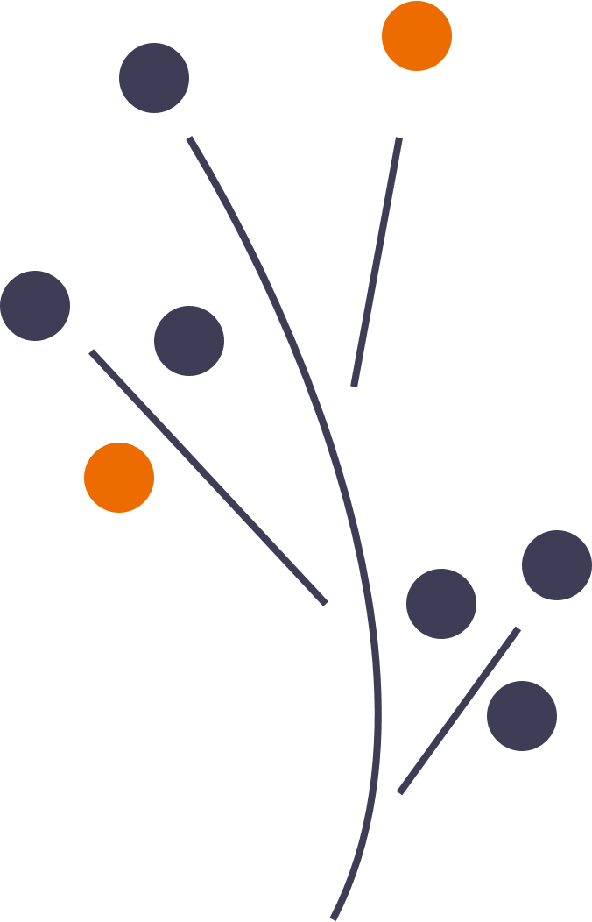


总结
CONCLUSION
Our Strassen's method runs faster than standard matrix multiplication, regardless of the choice of recursion point, matrix size and shape.
Which is due to the inefficiency of matrix elements indexing.
Code performance and user friendliness are both important, it matters to find the balance between the two.
Notes:
What we learned from this project is that, code performance
==========
Here we give our special thanks to

Slide 46
鸣谢
SPECIAL THANKS TO
SUN Jiachen, for providing us with testing platform
HAN Zichen, for offering professional advice on Python and other CS questions
All other classmates who helped us solve problems

Slide 47

THANKS
FOR LISTENING
And time for Q&A
Notes:
If we still got time for Q & A, just ask anything you wonder

